Slide 1
Chris Wells
Sprint 1 (09/16/2019)

Slide 2
Task 1: Add Search Bar Functionality
Before
After

Slide 3
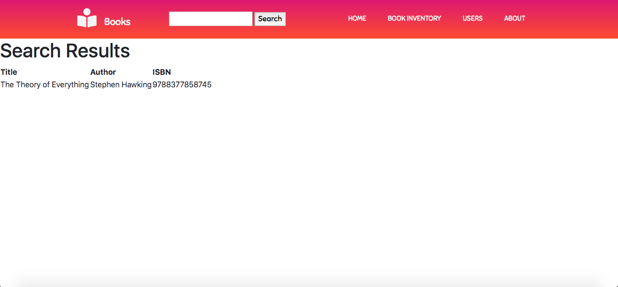
Task 1: Add Search Bar Functionality (Cont.)

Slide 4


Task 2: Develop Static Pages
Before
After

